Slide 1

By Oyaro

Slide 2

By the end of this session you should be able to
To define vaccines and their importance
To understand the development of a vaccine and its components
To know the types/classification of vaccines, and the advantages/disadvantages

Slide 3

Vaccines- all biological preparations, produced from living organisms, that induce immunity against disease and either prevent (prophylactic vaccines) or, in some cases, treat disease (therapeutic vaccines). Vaccines are administered in liquid form, either by injection, by oral, or by intranasal routes
Composed of diseases causing microorganism or some of its components

Slide 4
Agent stimulates the immune system to recognize it as foreign, destroy it and remember it.
Targets the adaptive immune system
Vaccines can be:
    Monovalent /univalent
    Multivalent /polyvalent
    Prophylactic or therapeutic

Slide 5

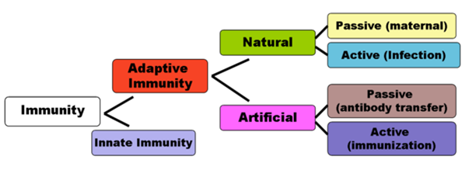

Slide 6

Administration of vaccine to induce immune response
Passive-transfer of antibody
Active-host induces the immune response
Immunization- stimulation of the immune system via use of infectious agents

Slide 7

Mimic natural infection and induce protective immunity by introducing pathogen components without causing disease
Induce immunologic memory which leads to a better and faster response upon pathogen exposure
Herd immunity- proportion of population that needs to be immunized to break transmission chain and provide protection to unvaccinated individuals

Slide 8

Antigens are divided into T cell dependent and T cell independent
The T cell independent are poor immunogens
Induction of a T cell dependent antibody response initially requires activation of the T helper CD4 lymphocytes by presentation of an antigen to the mononuclear phagocytes .(facilitated by adjuvants)
The presentation triggers secretion of a cascade of cytokine which stimulate maturation of T helper cells
This is followed by secretion of antibodies after a latent period.

Slide 9

IgM is detected first
Within 2-6 wks the igM titers drop and the IgG titers rise
In oral live vaccines, there is replication at the mucosal surfaces before host invasion and secretion of secretory IgA which neutralizes viruses efficiently, fix complement, prevent absorption of organisms to the intestinal wall and lyses gram negative bacteria.

Slide 10
The antibodies produced in response to vaccine constituents therefore may be
antitoxins
opsonins
lysins
neutralizing antibodies
antiadhesins
Immunologic memory created by the T and B lymphocytes leads to heightened immune response on second exposure characterized by marked proliferation of antibody producing B and effector T lymphocytes

Slide 11

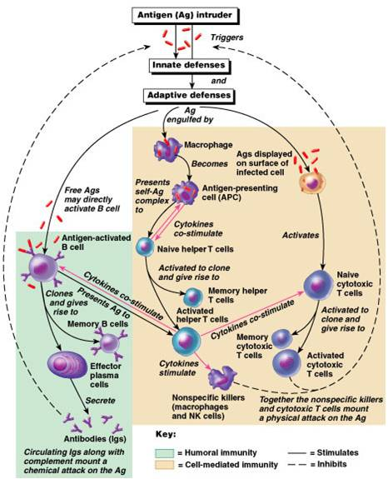

Slide 12

Science or methodology of vaccine development
Scientific research regarding the organism pathogenesis and immune response it confers
Identification of specific epitopes (antigenic determinants) to use as antigen
Antigen generation and isolated from cells used to generate it
Vaccine formulation
Pre clinical trials in animals
Clinical trial in human

Slide 13
  Phase 1-<100-safety, immunogenicity, dose response
  Phase 2-safety immunogenicity in several hundreds
  Phase 3-efficacy in thousands
  Phase 4-post marketing surveillance for safety and effectiveness

Slide 14

Adjuvant-non antigenic and enhance the immune response
    Enhance T cell activation by promoting the accumulation of APC at site of exposure
    Increases expression of co stimulant molecules cytokines, HLA peptide complexes on the APC
    Slowed release of the Ag for sustained immune stimulation(depot effect)
    Examples:liposomes,immune stimulating complexes,aluminium salts etc

Slide 15

Stabilizer- increases the storage life
Preservatives-prevent contamination by bacteria of fungi
  Allow use of multidose vials
Others include-suspending fluid ,antimicrobial agents

Slide 16

Long life immunity
Protective against all variants of the organism
Prevent disease transmission
Induce effective immunity rapidly
Transmit maternal protection to fetus
Few immunization to induce protection
Not administered by injection
Cheap, stable, safe

Slide 17

Live attenuated
killed
Toxoid
Subunit
Conjugate
Recombinant DNA based
Anti-idiotype

Slide 18

Live but virulent properties are disabled
Use closely related organism less virulent
Preferred in healthy persons
More durable immune response
Examples: Yellow fever, MMR, OPV, Typhoid, Rota

Slide 19

Outer coat is intact but the replicative function is destroyed
Heat, chemicals, radioactivity ,antibiotics
More antigen needed
Examples: IPV, Hepatitis A, Cholera, Rabies

Slide 20

Properties | Live vaccine | Killed vaccine
Dose | Low | High
No. of doses | Single | Multiple
Need for Adjuvant | No | Yes
Duration of immunity | Many years | Less years
Antibody response | Ig G | Ig A, Ig G
CMI | Good | poor
Reverse to virulence | Possible | Not possible

Slide 21

Inactivated toxic compounds that cause illness rather than the micro-organism
Examples: Tetanus, Diptheria

Slide 22

Purified subunit-fragment of the micro-organism is used to create immune response
    Example-hepatitis B surface protein
Recombinant-production of the unit via gene therapy
  Others-HPV vaccine caspid protein

Slide 23

Linking of the outer polysaccharide coat to a carrier protein
Polysaccharide has poor antigenicity
Important in infants
Examples: hemophilus influenza B vaccine, pneumococcal vaccine

Slide 24
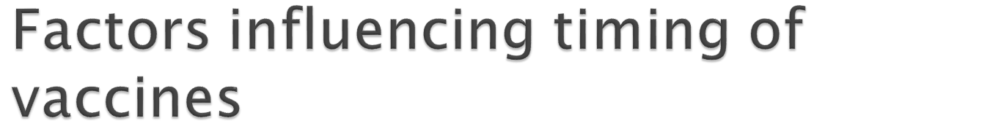
Nature of vaccine
Age specific risk of disease
Age specific risk of complications
Ability of a person at a certain age to respond to a vaccine
Potential of interferance with the immune response by passively transfered maternal antibody

Slide 25
Vaccine type | Recommended Childhood (ages 0-6) Immunization Schedule
Live, attenuated | BCG,OPV Measles, mumps, rubella (MMR combined vaccine) Varicella (chickenpox)* Influenza (nasal spray)* Rotavirus*
Inactivated/Killed | Polio (IPV)* Hepatitis A*
Toxoid (inactivated toxin) | Diphtheria, tetanus (part of DTaP combined immunization)
Subunit/conjugate | Hepatitis B Influenza (injection)* Haemophilus influenza type b (Hib) Pertussis (part of DTaP combined immunization) Pneumococcal Meningococcal* HPV*

Slide 26

Eradication of small pox-success story-1979
Experimental types of vaccines
    Dendrintic cell vaccine combination
    Recombinant DNA vaccines based-hepatitis B (yeast based)
    Cancer vaccines-Targeting induction of cytokines-TNF,IFN
    T cell receptor peptides vaccine
    Identification and Neutralizing the key bacterial virulence mechanism
    Others
    For inducing infertility
    Treatment of drug dependence

Slide 27

  Pathogen variability
  Genetic variability
  Complex infectious process
  Poor vaccine coverage

